Slide 1

FINAL
YEAR PROJECT
Shri Ramdeobaba College of Engineering and Management

Slide 2
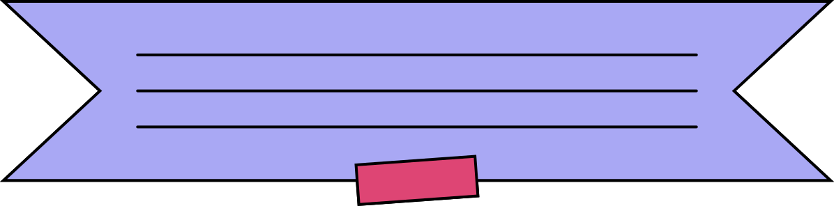

HOW DOES A ML ALGORITHM WORK?
Training
Validation
Testing
1.Data Collection
2.Data Preprocessing
3.Splitting the Data
4.Model Selection
1.Training the Model
2. Validation
3. Hyperparameter Tuning
Testing and Evaluating
Deployment

Slide 3

Manual Data Collection: Collect data through surveys, observations, or manual entry
Public Datasets: Use publicly available datasets from sources like Kaggle
Web Scraping: Extract data from websites using scraping tools like Beautiful Soup or Scrapy
Data Collection
APIs (Application Programming Interfaces): Gather data from external sources via APIs

Slide 4
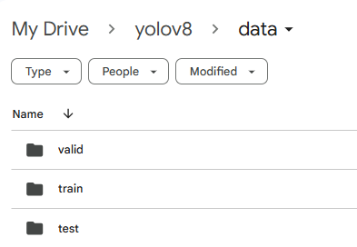
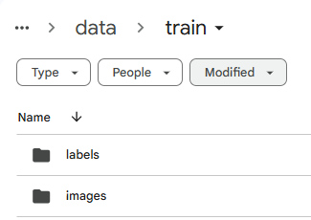
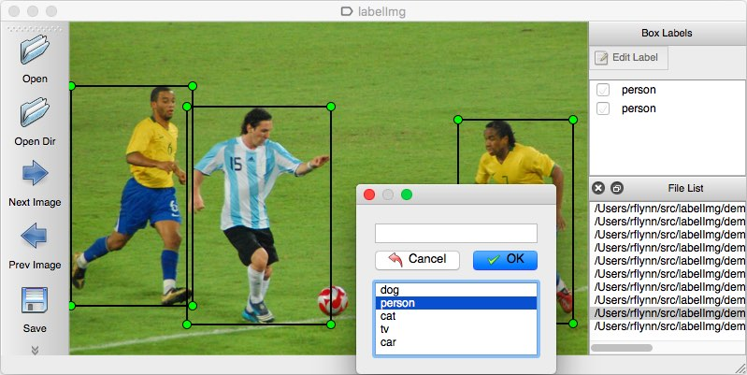
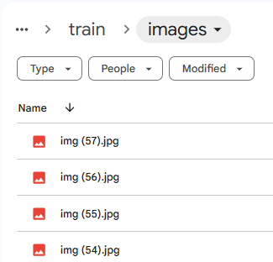
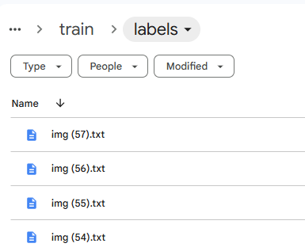
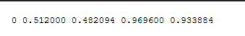
Labellmg
Bounding boxes
classes
coordinates

Slide 5
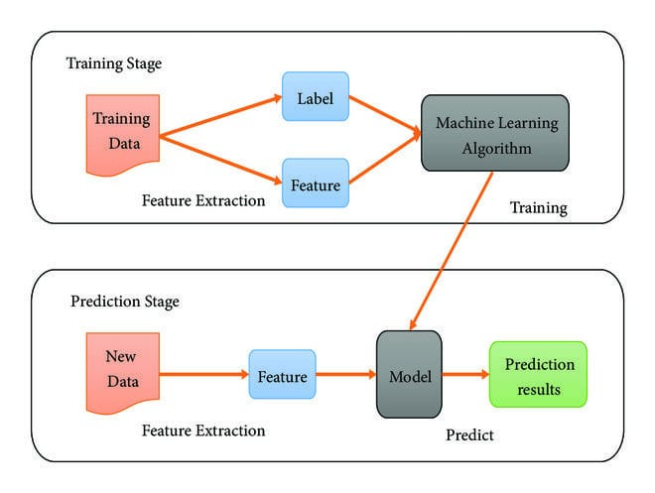
HOW DOES A ML ALGORITHM WORK?
Training
Validation
Testing
1.Data Collection
2. Data Preprocessing
3. Splitting the Data
4. Model Selection
1.Training the Model
2. Validation and Hyperparameter Tuning
Testing and Evaluating
Deployment

Slide 6



PROBLEM
STATEMENT
We need tons of images to train a good ml model.
In the development of image detection models, one of the primary challenges is the time-consuming and labor-intensive process of manually annotating images.
A large amount of annotated image data is required to train effective models, but the manual annotation process creates significant bottlenecks, hindering the speed and scalability of model development.
These challenges limit the availability of high-quality annotated datasets, making it difficult to develop and deploy accurate image detection systems.
We need more variety and diversity in images with annotations
Getting diverse images can be achieved but annotating this tons of images is not feasible at all

Slide 7
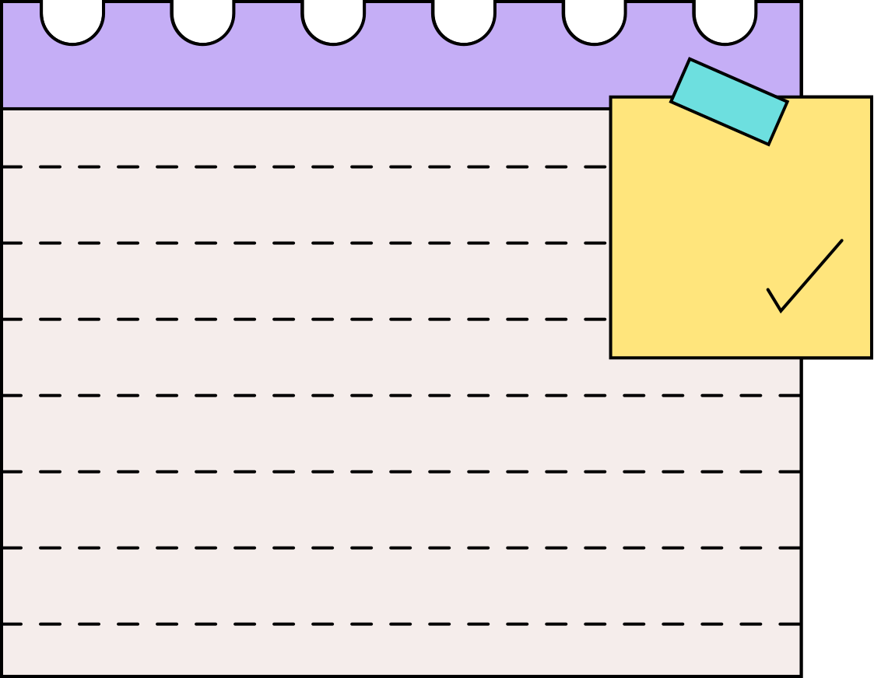
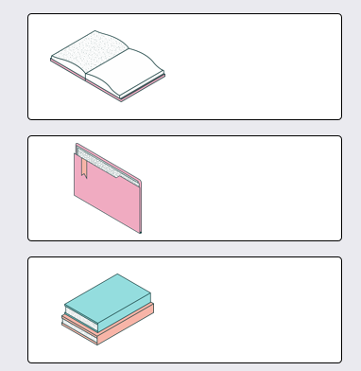
WHAT IS OUR AIM?
The aim of this project is to develop an innovative approach to dataset augmentation for image detection models by leveraging Generative AI techniques. Image detection models rely heavily on large, annotated datasets for effective training, but the process of manually annotating these datasets is labor-intensive, time-consuming, and often prone to error. As a result, acquiring enough high-quality data for model training poses a significant challenge
IMAGES + ANNOTATIONS
We input images and annotations from user
DATASET
MULTIPLICATION
ALGORITHM
MULTIPLE DATASET
WITH BUILT IN ANNOTATIONS

Slide 8





APPROACH
Segmentation: Extract foreground objects and backgrounds from the original images
By following this approach, we aim to produce a significantly larger set of augmented images, each with corresponding annotations. This will provide a robust and diverse training dataset for image detection models, ultimately improving their performance and accuracy.
Bounding Box Adjustment: Jiggle the object bounding boxes with a known offset to create variations in object placement.
Annotation Adjustment :Adjust the annotations to reflect the new object positions, ensuring accuracy
Overlay and Synthesis : Overlay the augmented foreground objects onto the augmented backgrounds to generate new images.

Slide 9
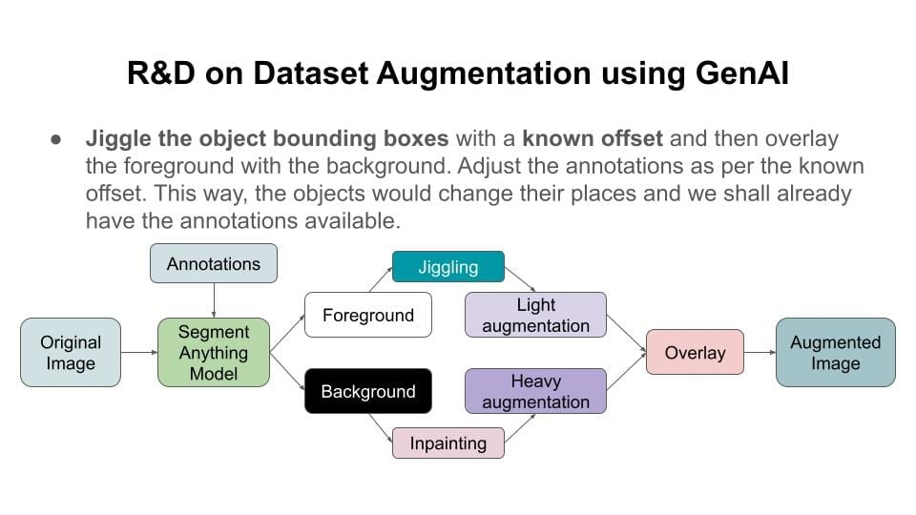
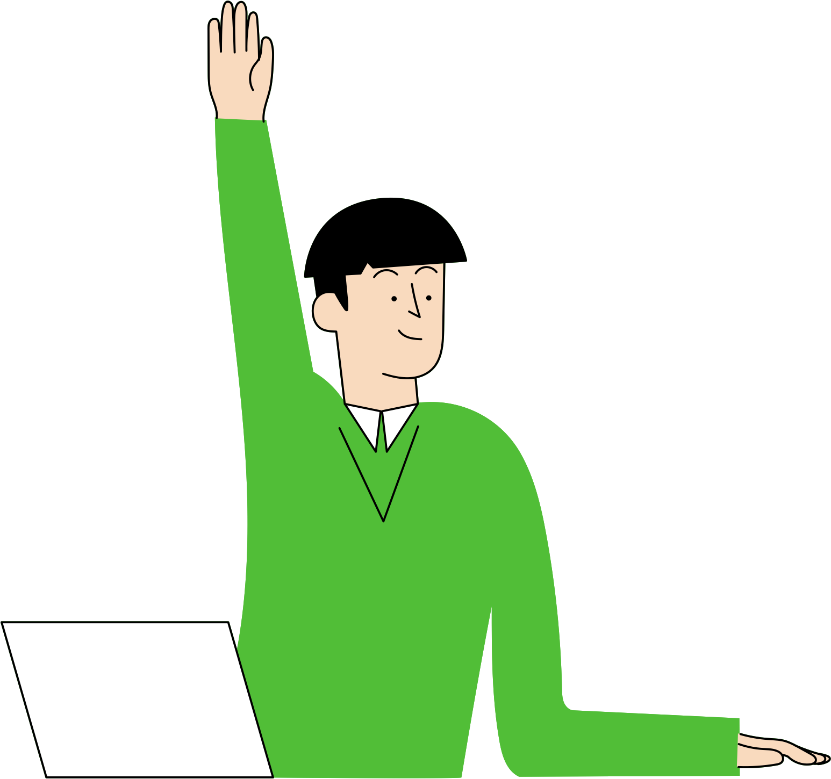
PUTTING IT ALL TOGETHER

Slide 10

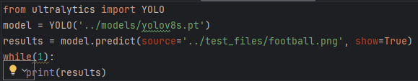
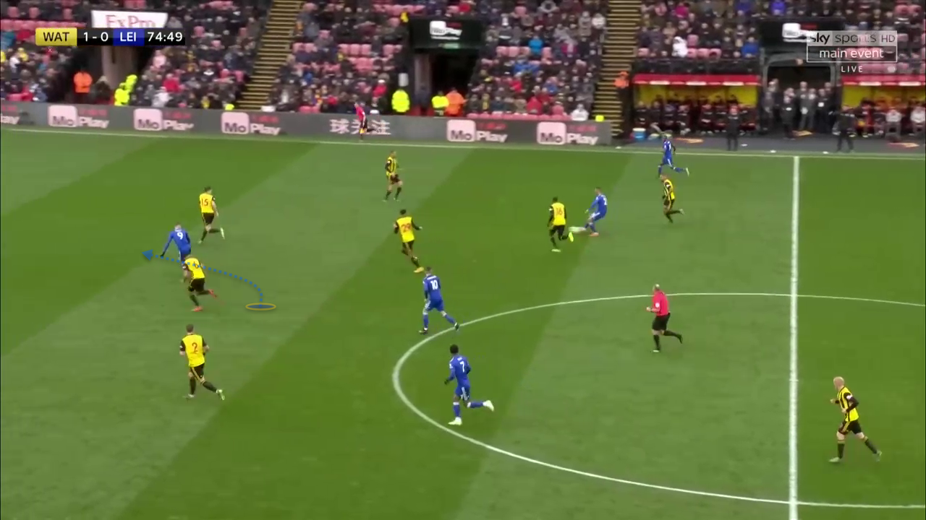
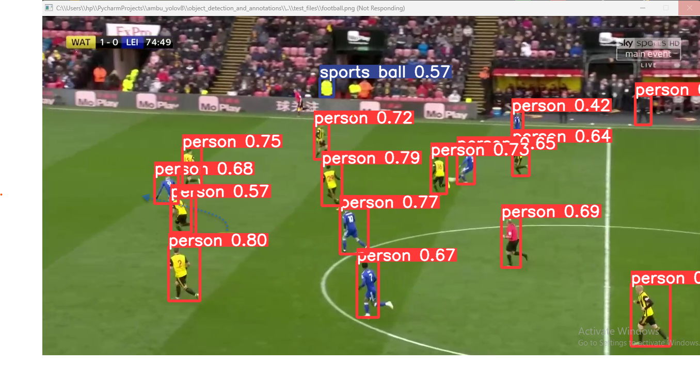
OBJECT IDENTIFICATION
Each image has its target object which needs to be identified.
This can be achieved by various object detection models like YOLO.
The target is detected, and its corresponding coordinates are saved and given to SAM.

Slide 11
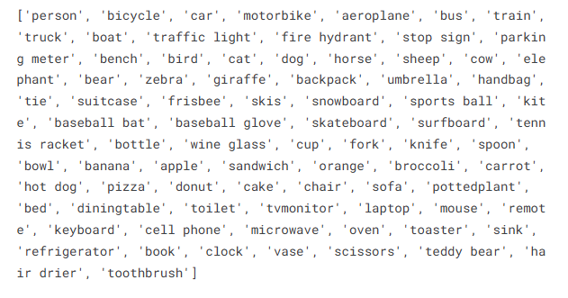

YOLOv8(You Only Look Once)
YOLOv8 (You Only Look Once, Version 8) is the latest iteration of the YOLO family, designed for high-speed and accurate object detection tasks.
Coco. Names : for predefined models
If we want to create a custom model we need to train our model in order to detect object. In this process we need datasets and along with their annotations
Images *1000
Custom Model
Datasets
Annotations *1000 ??

Slide 12
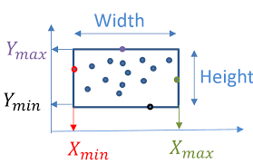
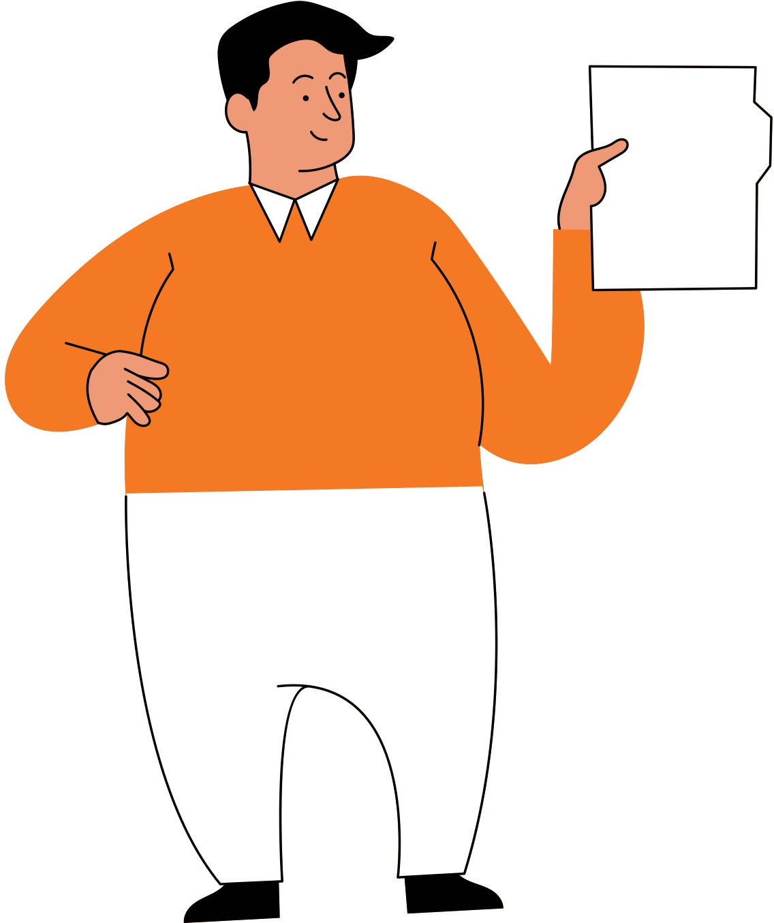
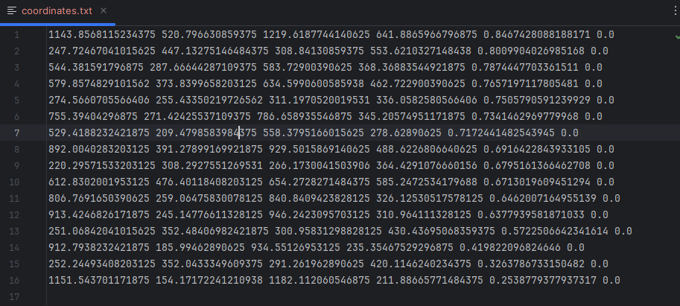
Bounding Boxes and Coordinates
Each identified object has its bounding box and coordinates of itself.
confidence
class
box
Xmin
Ymin
Xmax
Ymax
Confidence
Person
Class
Each line display the coordinates ,confidence and class of that object

Slide 13


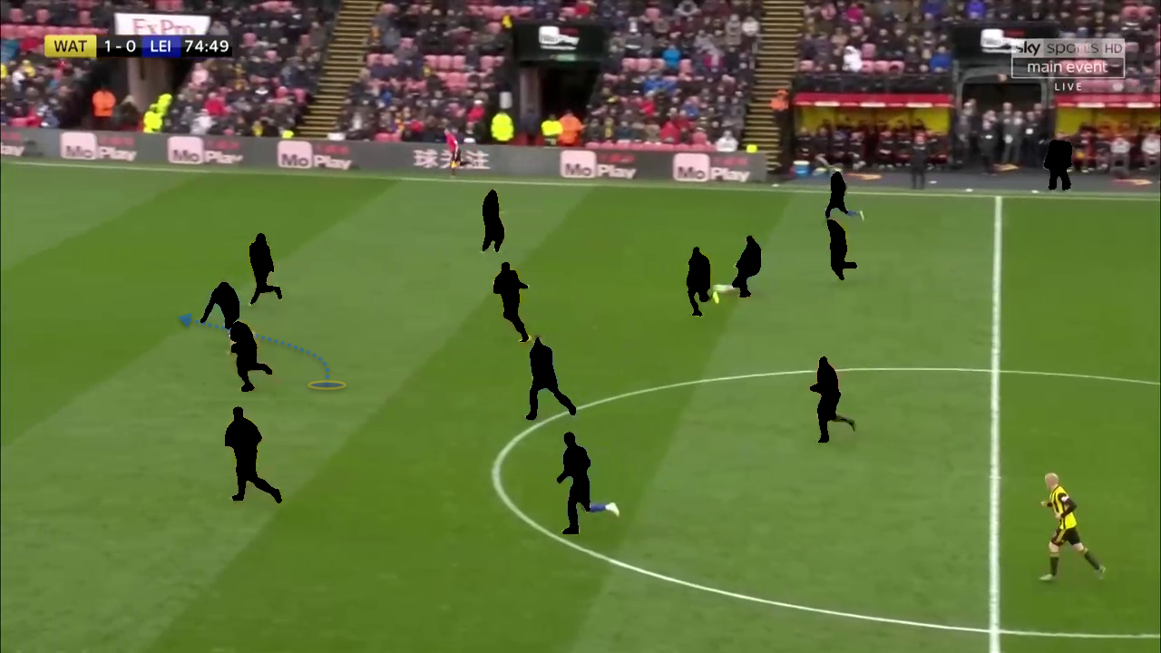
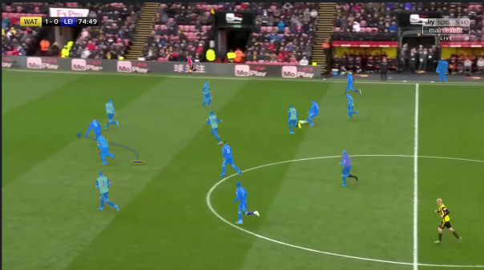
SEGMENTATION
The basic idea of segmentation is dividing the image into target and background
All possible targets will be identified using object detection mechanism and all things except the target will be considered as background.
Image
foreground
background
Foreground+x
Foreground-x
background
New Image

Slide 14
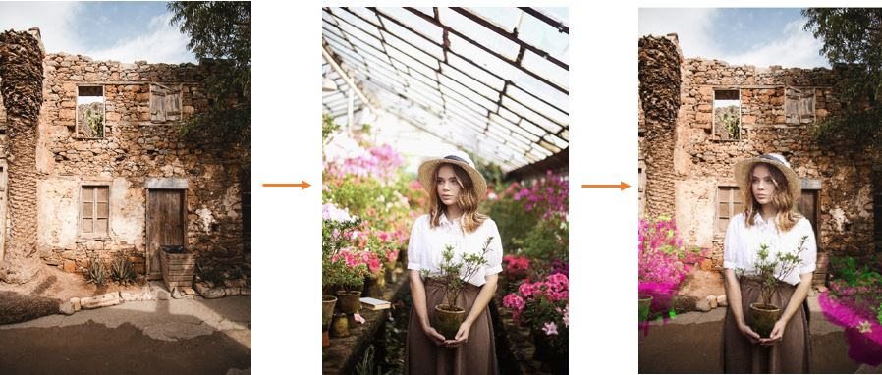

SAM(Segment Anything Model)
SAM (Segment Anything Model) allows users to generate precise masks for objects in images, regardless of the object type.
Works with different types of prompts, including points, boxes, and masks, to segment objects.
Users can interactively refine segmentation by providing additional prompts.

Slide 15

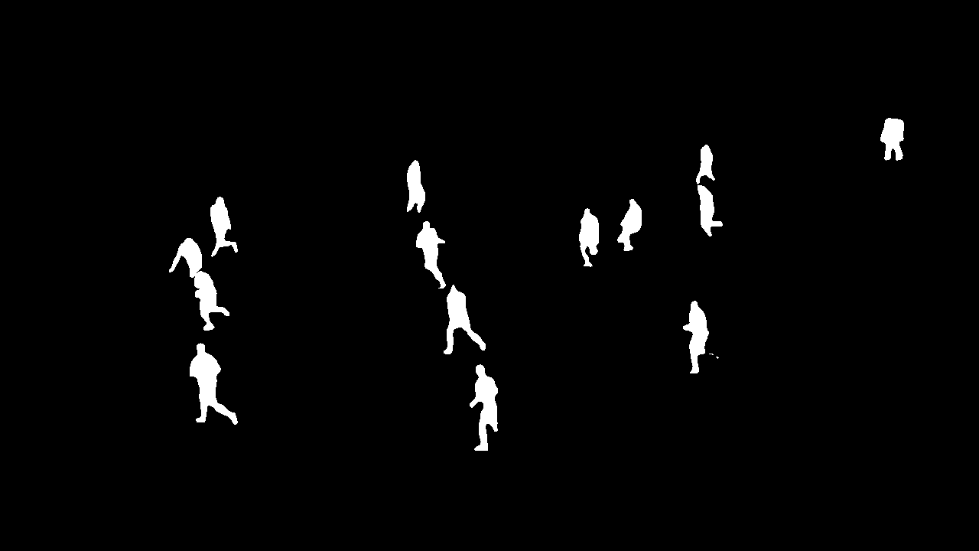

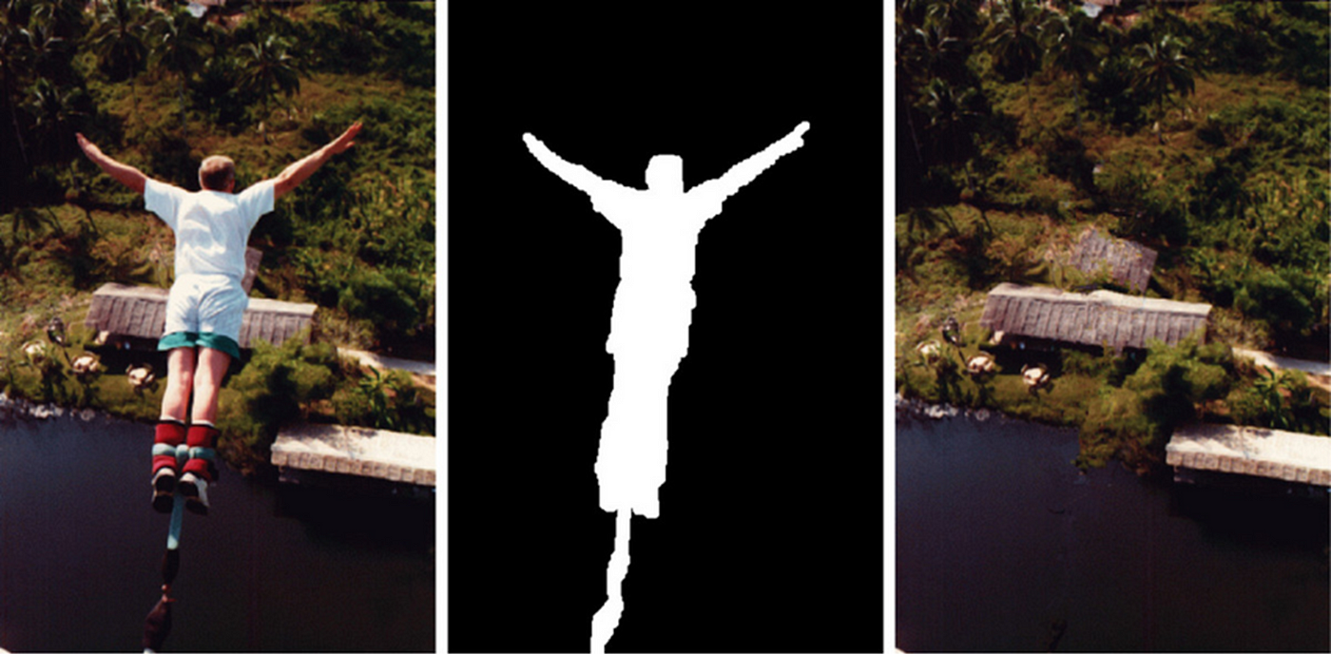
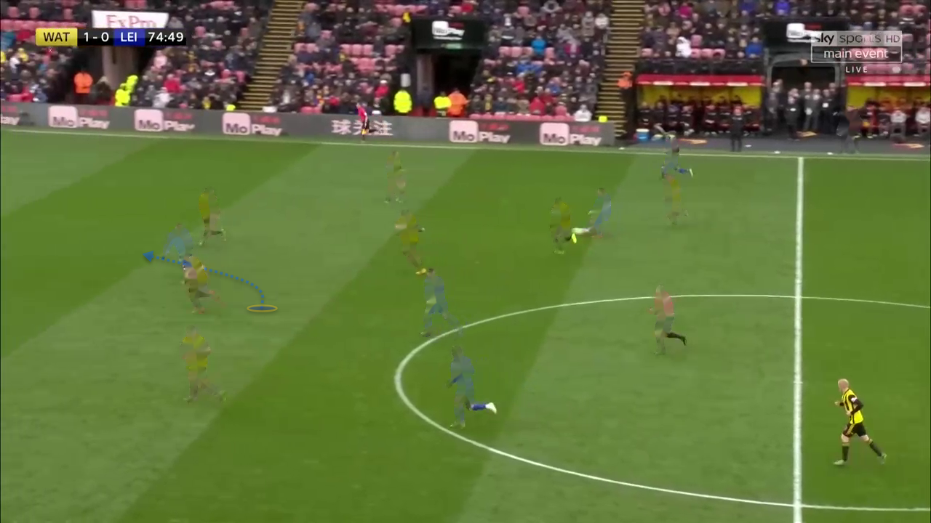

IMAGE INPAINTING
Brainstorm: Write down your reasons
for your opinion.
Image inpainting is like digital "magic" for fixing or filling in missing or damaged parts of a picture.
Discuss: Talk and listen about your
and others' ideas.
Record: Write down the reasons you discussed.

Slide 16
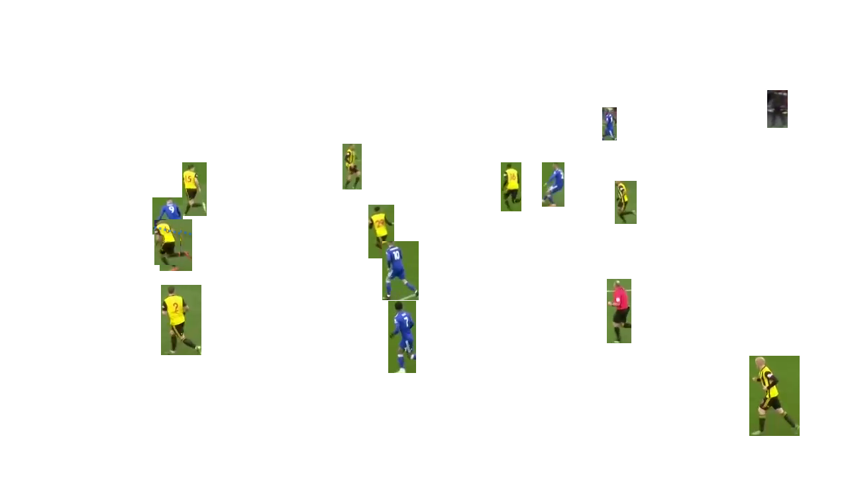
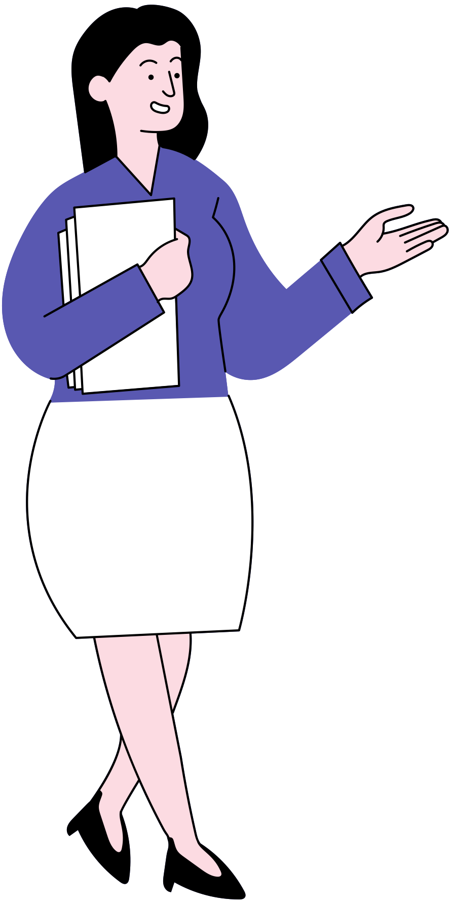
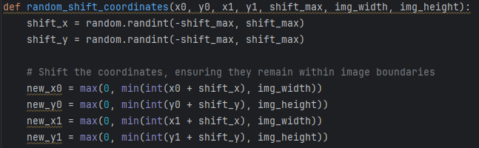
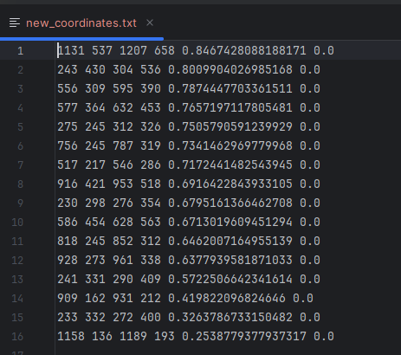
Jiggling
Coordinates are jiggled and assigned new co-ordinates so new position are created and later can be overlayed
Jiggling is a basic idea of moving detected objects by a certain length maybe left right top or bottom.
This length is later added to original coordinates of original image in order to get the new co-ordinates of jiggled objects.
Pasting this image on the inpainted background gives a new image.
Thus a new image can be created.
Image
Jiggled Image
foreground
background
Foreground+x
Foreground-x
background
New Image
Diff =
1143 – 1131
=12

Slide 17
Old Coordinates

Slide 18
New Coordinates

Slide 19
PUTTING IT ALL TOGETHER

Slide 20
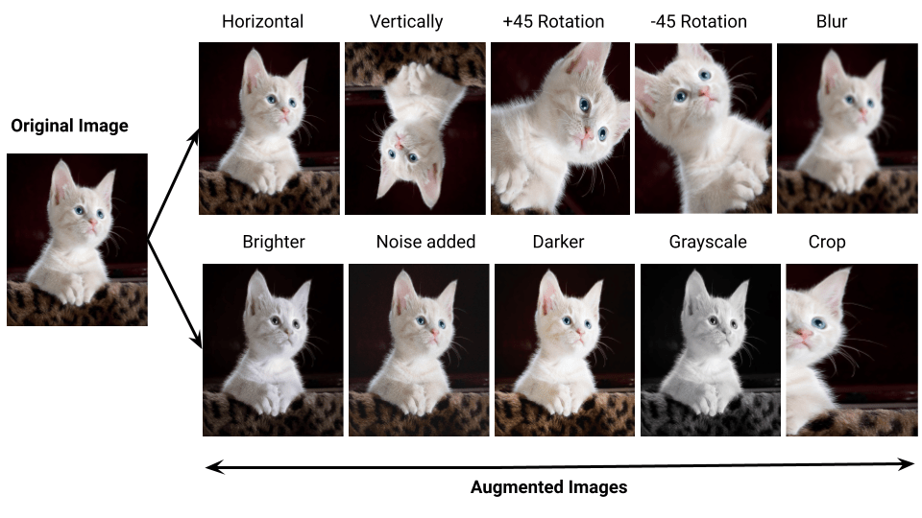
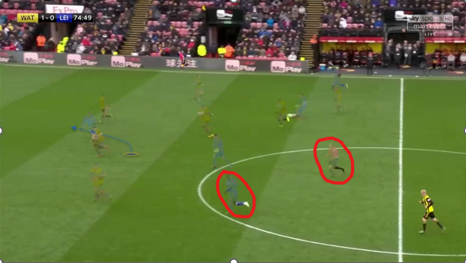
AUGMENTATION
Augmentation includes adjusting colours and making images ready for overlaying.
Heavy augmentation includes adjusting colours and making a smooth background .
Image need heavy augmentation for overlaying
Image need light augmentation for overlaying
Main aim -> We need these 2 images to share same type of color shading, brightness and other image features to appear one after overlaying.

Slide 21

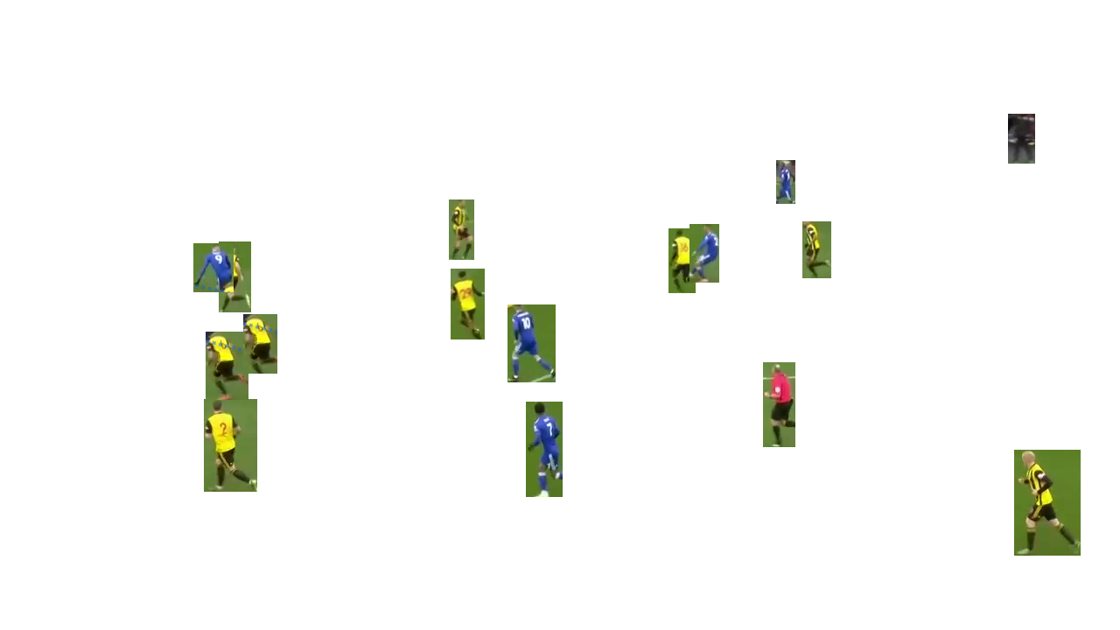
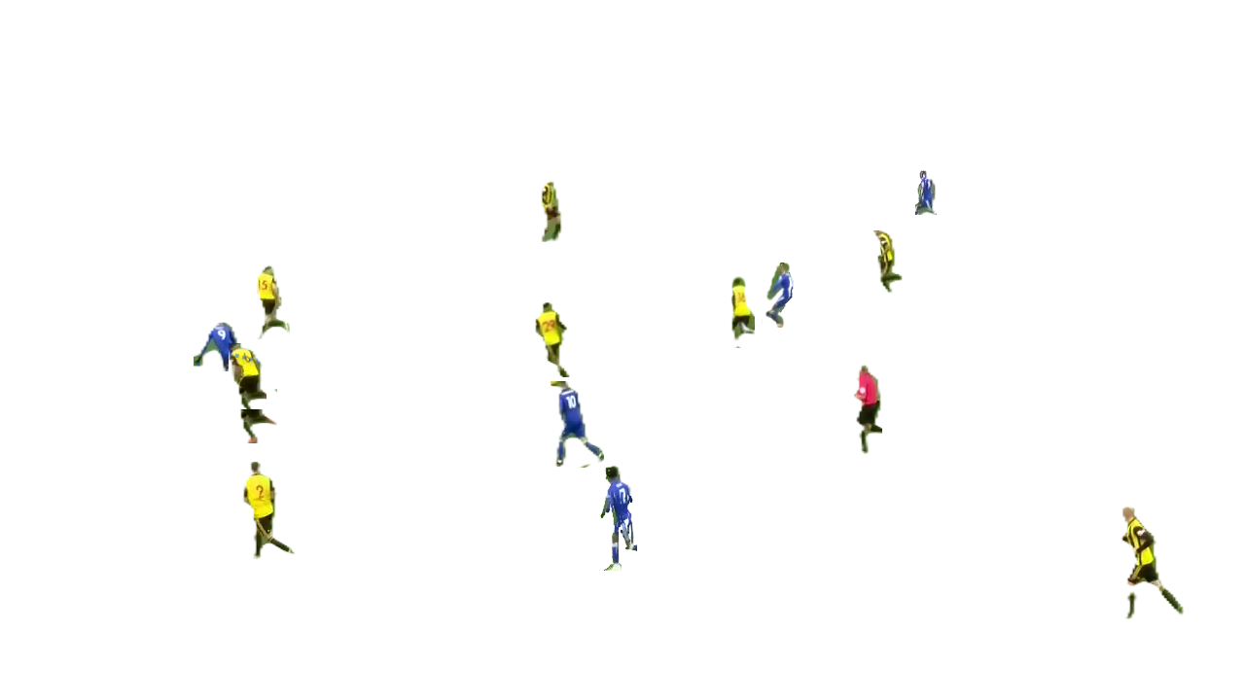

RESULTS :

Slide 22
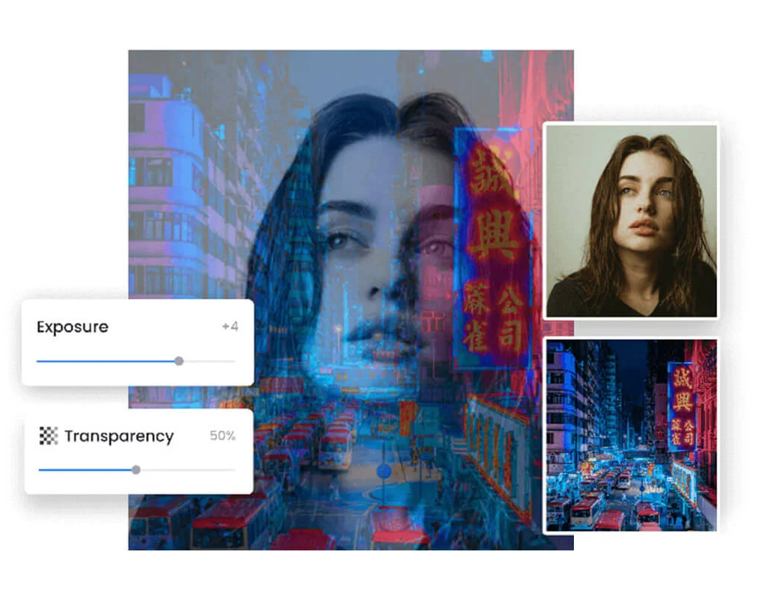
OVERLAYING
Overlaying include adding new created background and moved targets to create a new images.
Thus combing them with multiple coordinates results in multiple images and improving datasets with immense images.
New
image
+
=
Inpainted Image
Jiggled Image

Slide 23
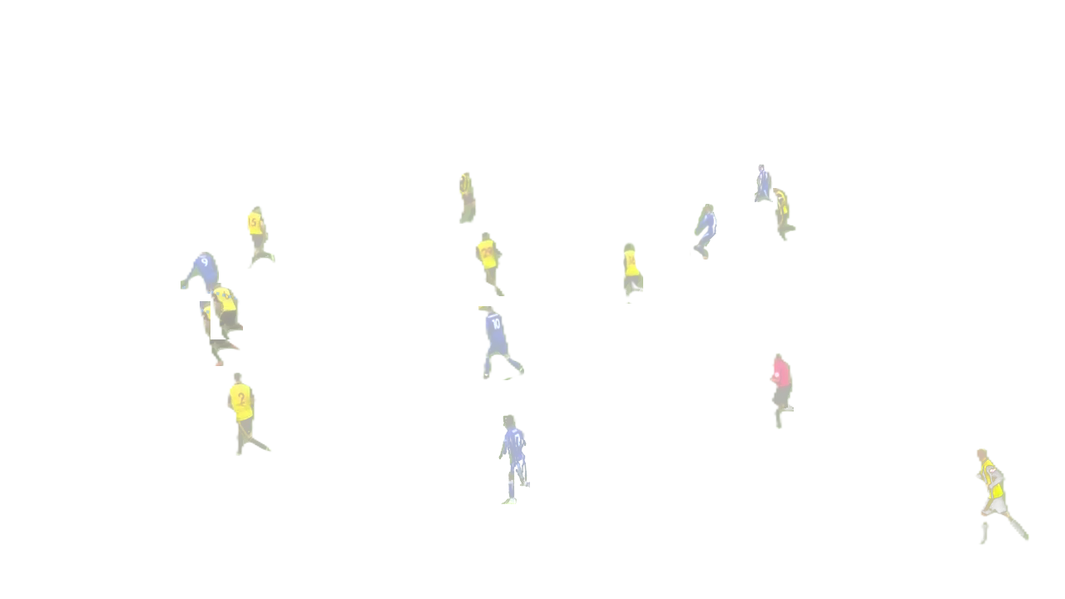
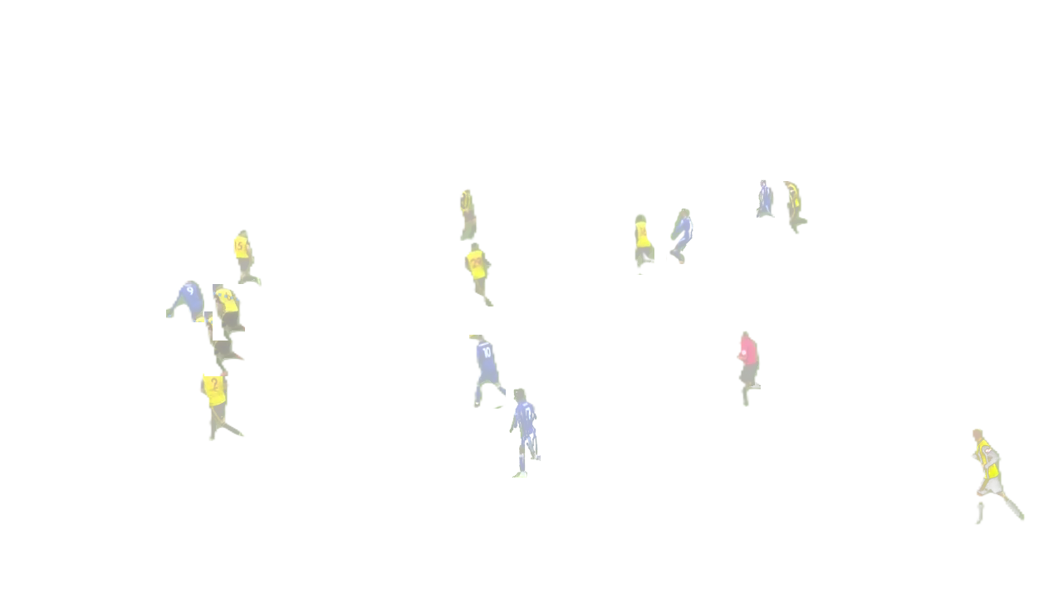
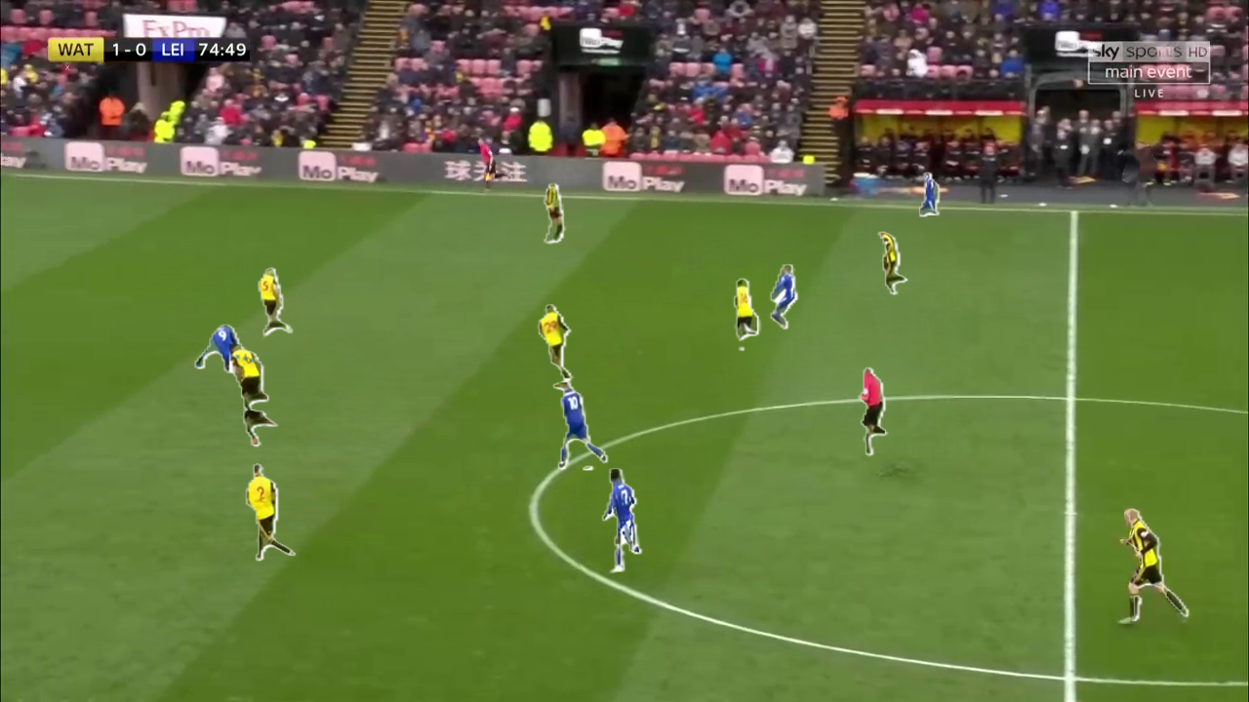
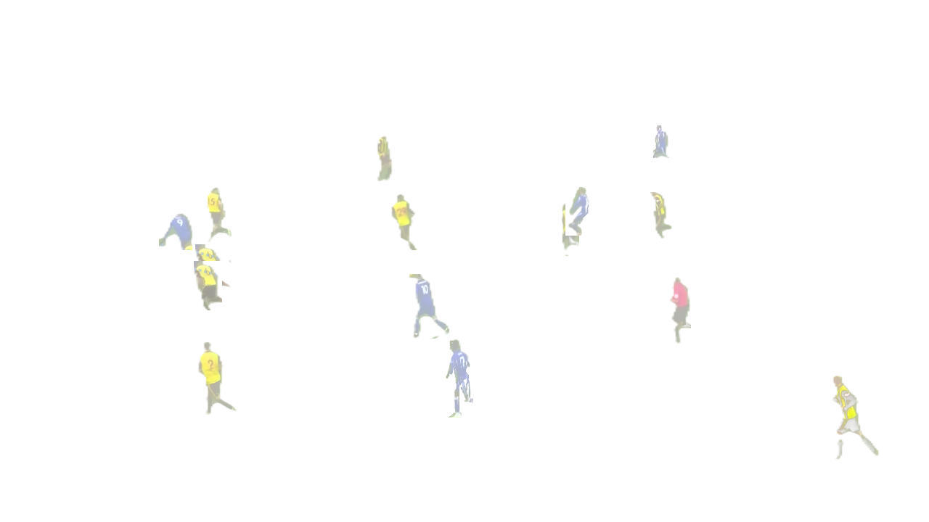
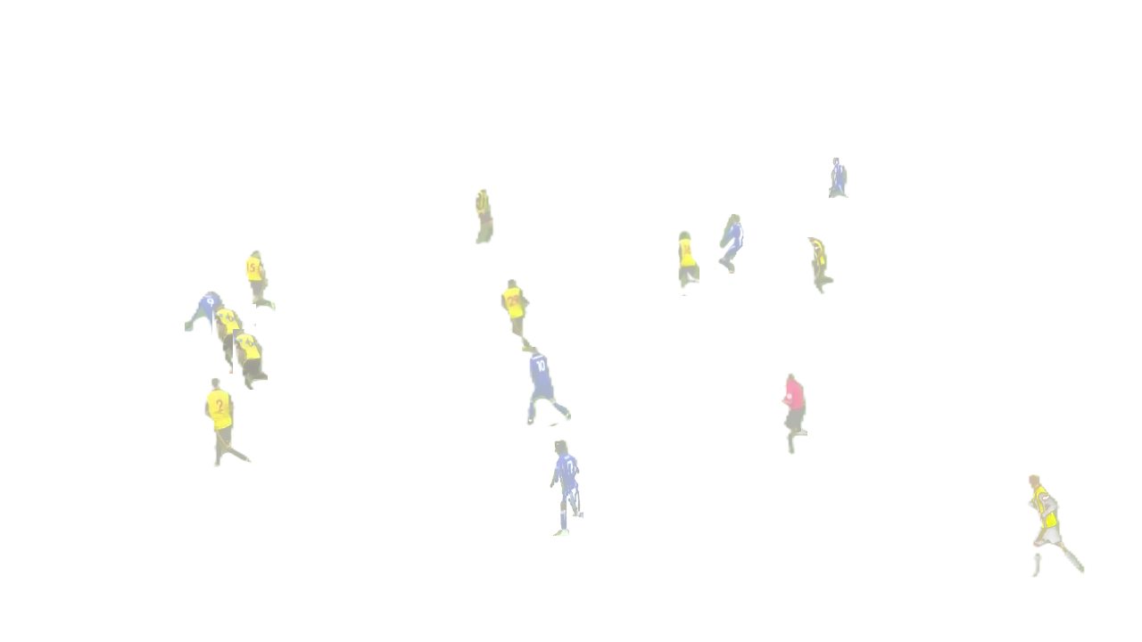
OVERLAYING
JIGGLED FOREGROUNDS
BACKGROUND

Slide 24
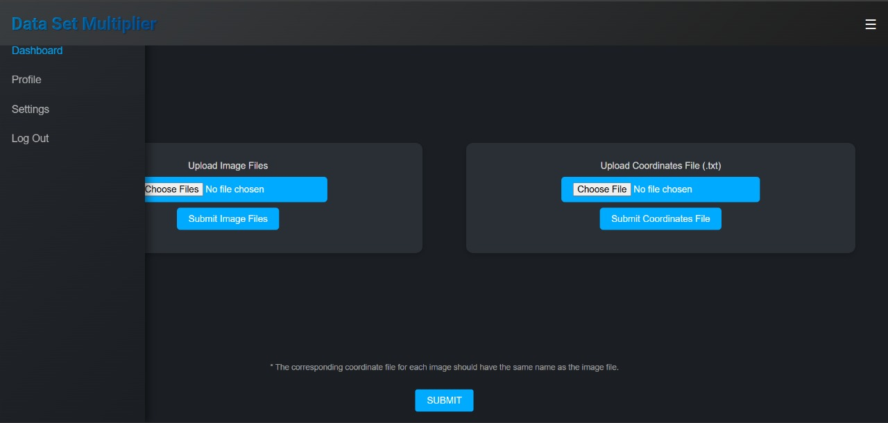
PUTTING IT ALL TOGETHER

Slide 25
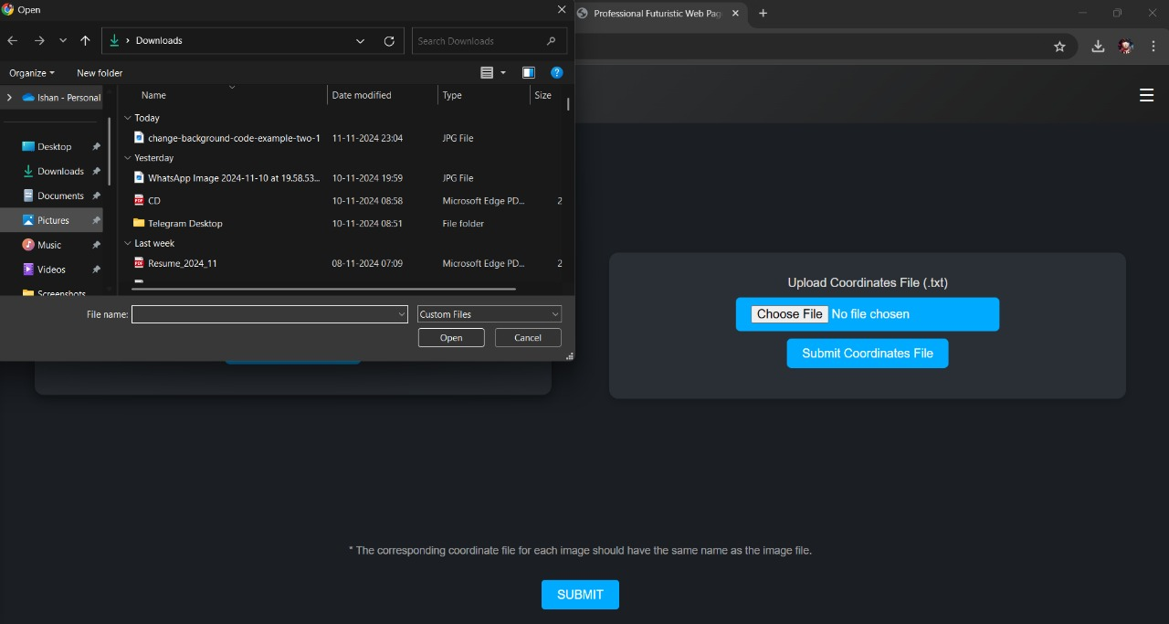
PUTTING IT ALL TOGETHER

Slide 26
Conclusion
The project successfully demonstrated that leveraging techniques for dataset augmentation significantly reduces the dependency on manual annotation while maintaining or improving the quality of image detection models. The outcomes of this project can be summarized as follows:
Conclusions
On completing this project, we will achieve these conclusion
Conclusion 1
Conclusion 2
Conclusion 3
Increased Efficiency in Dataset Creation
Improved Model Performance
Scalability of Model Development

Slide 27
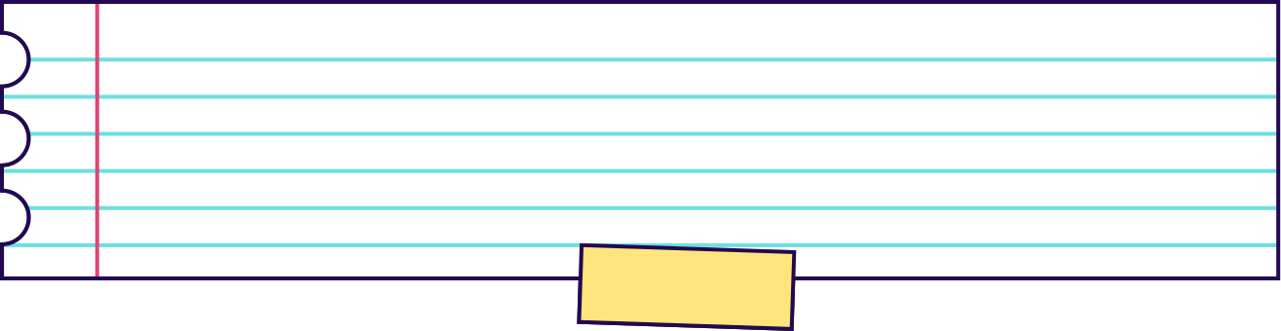
Future Work
A promising extension of the project is to deploy the dataset augmentation system as a user-friendly web-based application. This would make the solution accessible to a wide range of users without requiring technical expertise or local setup.
Objective : Develop a webpage that allows users to generate augmented datasets using Generative AI techniques with an intuitive interface. Here's an outline of this future project:
Dataset Upload Augmentation
Preview and Edit Batch Processing
Download Options

Slide 28


Slide 29

Conclusion :
The project successfully demonstrated that leveraging techniques for dataset augmentation significantly reduces the dependency on manual annotation while maintaining or improving the quality of image detection models. The outcomes of this project can be summarized as follows:
Increased Efficiency in Dataset Creation
Improved Model Performance
Scalability of Model Development

Slide 30


SEGMENTATION
The basic idea of segmentation is dividing the image into target and background
All possible targets will be identified using object detection mechanism and all things except the target will be considered as background.
With the rise of technology, many people are feeling more connected than ever. It can help us to connect with our friends and family from anywhere in the world.
On the other hand, some feel that technology pushes us further apart. It can distract us from spending quality time together and make us feel more isolated.

Slide 31
PUTTING IT ALL TOGETHER
Answer
Technology pushes us further apart.
Reason 1
Reason 2
Reason 3
Technology keeps us from spending quality time with loved ones.
Seeing perfect lives online can make us feel insecure or unhappy.
Too much technology makes us less active and more unhealthy.
Thesis Statement
Technology pushes us further apart as it keeps us from spending quality time with loved ones, it can make us feel insecure or unhappy, and it can make us less active and more unhealthy.

Slide 32
MAINTAINING A FORMAL STYLE
Eliminate personal pronouns (e.g. "I" or "you").
Incorporate expert opinions or scholarly consensus.
Some tips for writing your thesis statements in a formal style.
Use precise and academic language.
Clearly state your opinion, avoiding vague language.

Slide 33

MAINTAINING A FORMAL STYLE
See the example below which shows an improved thesis statement.
Original Thesis
Improved Thesis
Technology pushes us further apart as it keeps us from spending quality time with loved ones, it can make us feel insecure or unhappy, and it can make us less active and more unhealthy.
Technology has the potential to create distance between people, impede quality time with loved ones, create feelings of insecurity and unhappiness, and contribute to an inactive and unhealthy lifestyle, as affirmed by experts in the field.

Slide 34


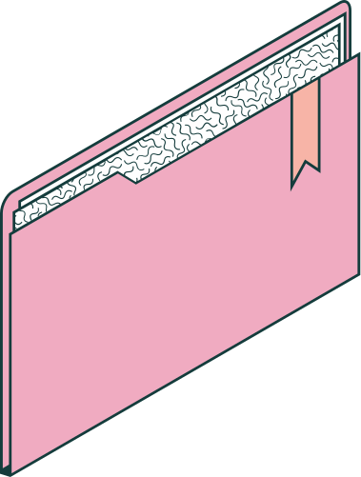

THANK YOU
FOR LISTENING!
Today, you have learned how to write a thesis statement and should now understand . . .

Slide 35







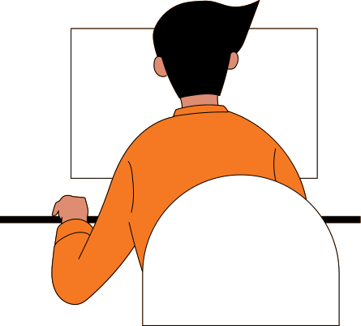









RESOURCE
PAGE
Use these design resources
in your Canva Presentation.
This presentation template
uses the following free fonts:
Titles: Titillium Web
Headers: Titillium Web
Body Copy: Titillium Web
You can find these fonts
online too. Happy designing!
Don't forget to delete this
page before presenting.

Slide 36
RESOURCE
PAGE
Use these design resources
in your Canva Presentation.
This presentation template
uses the following free fonts:
Titles: Titillium Web
Headers: Titillium Web
Body Copy: Titillium Web
You can find these fonts
online too. Happy designing!
Don't forget to delete this
page before presenting.

Slide 37
